Slide 1
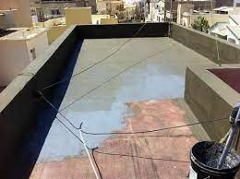
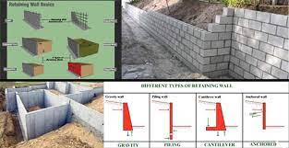
Waterproofing
Places where waterproofing is essential:
1.Square feet of the building
2.Foundations walls

Slide 2
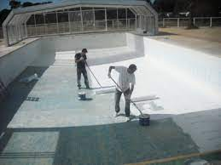
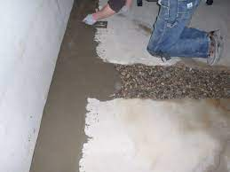
3. Swimming pools
4. Basement of buildings

Slide 3
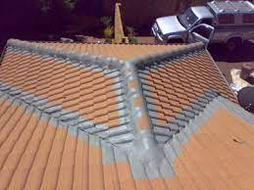
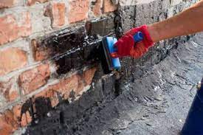
5.Roofs
6. Bricks

Slide 4
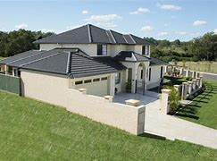
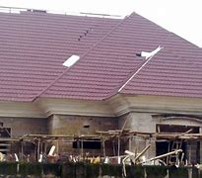
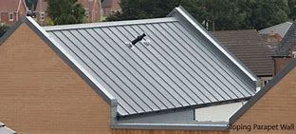
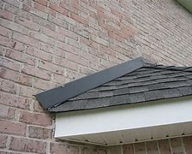
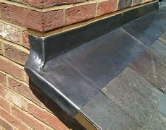
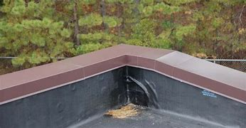
Types of roofs and waterproofing methods
1. Parapet roofs
2. End wall flashings

Slide 5
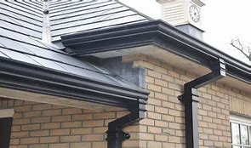
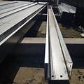
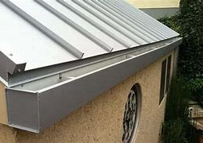
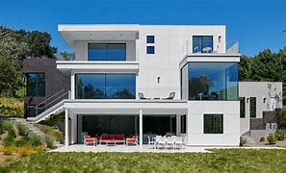
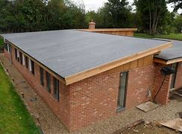
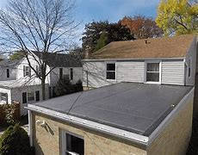
3. Box gutters
4. Flat roof
Materials of waterproofing.
1. Cementitious waterproofing.
2. Liquid waterproofing membrane.
3. Bituminous membrane waterproofing.
4. Polyurethane liquid membrane.

Slide 6
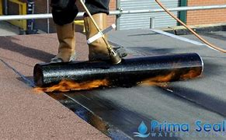
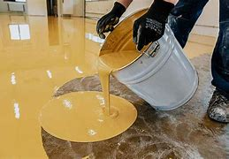
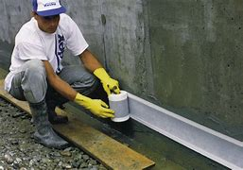
Types of waterproofing methods
1.Sealers
2. Epoxies
3. Membrane

Slide 7
Causes of roof leakages in concrete tiles and corrugated.
1. Age
2. Damaged or poorly installed flashing.
3. Broken or missing tiles or slates.
4. Damaged roof membrane or underlay.
5. Using wrong roof materials.
6. Poorly fixing.
7. Condensation in loft space.
8. Poorly installed skylights or roof windows.
Repair of roof leakage
Video
-
Feedback : Activity

Slide 8
Kwa Thema Skills School
Subject : Maintenance Marks : 10
Grade : Year 2 Time : 30mins
Date :
Question:1
1.Name the following hand tools that are used in waterproofing, painting and glazing.
1.__________________ 2.______________________
3.___________________ 4. ______________________

Slide 9
Question:2
1.Name six causes of roof leakages.
1.1 ____________________________________
1.2 ____________________________________
1.3 ____________________________________
1.4 ____________________________________
1.5 ____________________________________
1.6 ____________________________________
(10)

